Slide 1
Glitch-Free Clock Multiplexer with Symmetric Failover: Design and Implementation
Tutor: PhD. Thuan Van Le
Contributor 1: Hai Minh Truong
Contributor 2: Phuong Thi Vu

Slide 2
Introduction
Clock switching in multi-clock SoC/FPGA systems is a critical challenge
Conventional designs suffer from glitches, metastability, and deadlock under clock failure
Existing solutions cannot simultaneously guarantee glitch-free, deadlock-free, and autonomous failover
This work proposes a novel GFCM architecture enabling safe switching and reliable recovery without external reference clock

Slide 3
Contents
Problems
Classical Model
Prior Work and Limitations
Design Objectives
Proposed solution
Conclusion

Slide 4
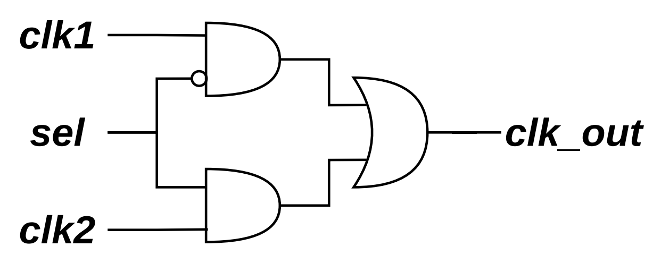
1.Problems:
Glitch: an unwanted short pulse at the output caused by unsynchronized switching between signals or clocks
Notes:
Glitch (unsynchronized)

Slide 5
Metastabilities between 2 clock domain (2flipflop to solve)
Synchronize?
Probs (H or L ?)
Solution
Indeterminate state caused by asynchronous sampling near clock edge
Notes:
metastability

Slide 6
Deadclock
Deadclock
The system enters a deadlock condition, resulting in the output clock being stuck at a constant logic level (no toggling)

Slide 7
Main problem:
Notes:
Prob: unsynchronize (purely combinational logic) -> adding flipflops

Slide 8
Deadclock
Deadclock
The system enters a deadlock condition, resulting in the output clock being stuck at a constant logic level (no toggling)

Slide 9
2. Classical Model
Trad model:
Notes:
Glitch (unsynchronized)

Slide 10
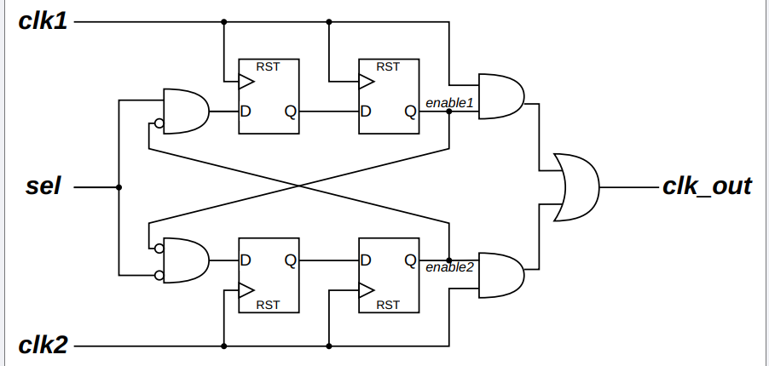
Break-before-make model:
3. Prior Work and Limitations
2. Classical Model
Posedge?

Slide 11
Break-before-make model:
Solutions

Slide 12
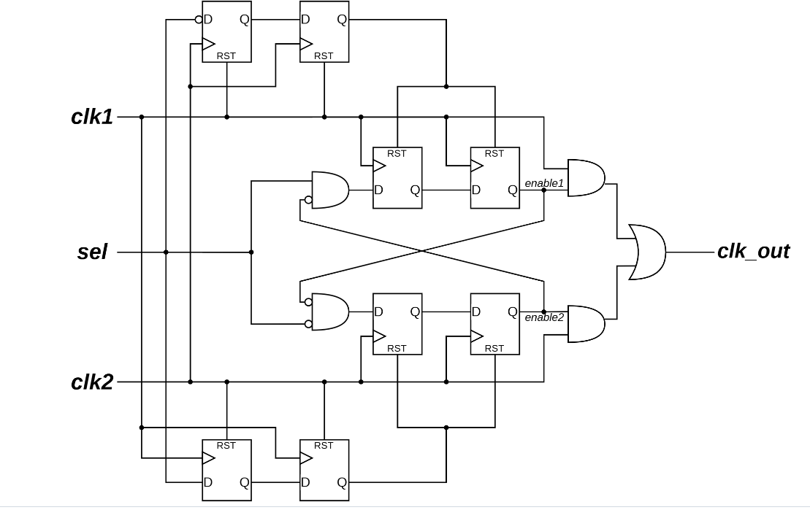
Timer-based model:

Slide 13
Timer-based model:

Slide 14
3. Design Objectives
Glitch-free switching
Deadlock-free operation under clock failure
Autonomous failover and safe recovery
Safe operation under dual-clock failure scenarios
No external reference clock required
Safe CDC across clock domains

Slide 15
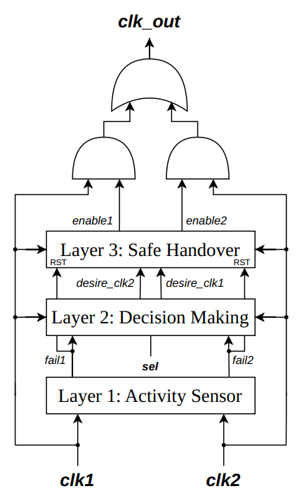
Proposed-block diagram
4. Proposed solution
Notes:
Layer 1: die or live
Layer 2: sync with sel (if selected clock died, other lives) → others. And normal, normal
Layer 3: synchronize and break before make

Slide 16
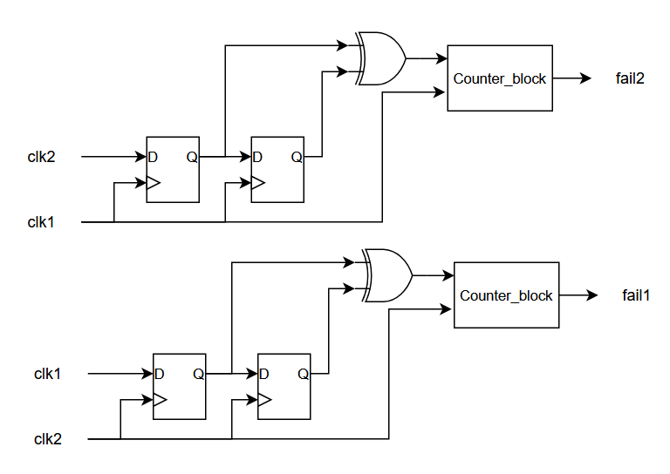
Layer 1:

Slide 17
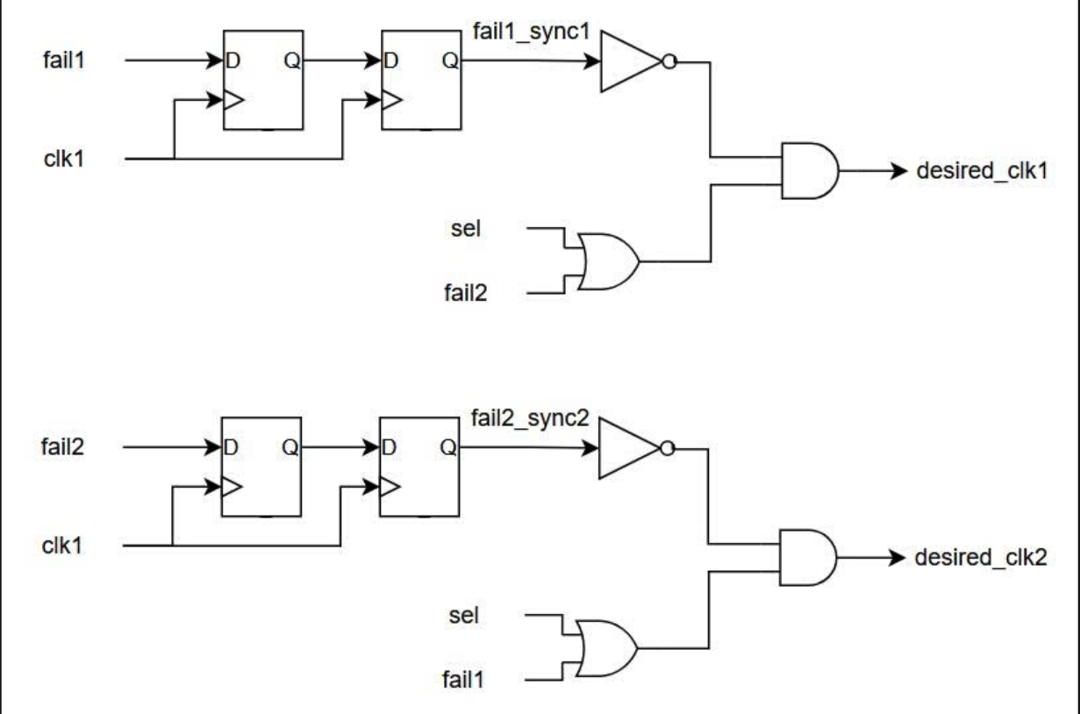
Layer 2:

Slide 18
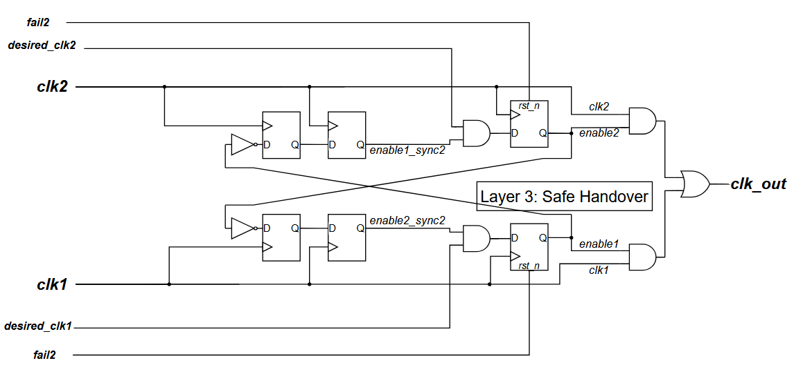
Layer 3:

Slide 19
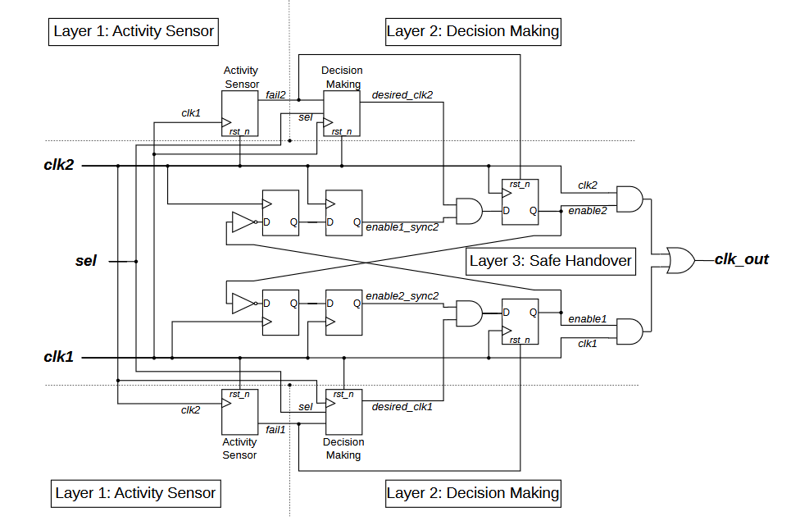
Proposed-scheme

Slide 20
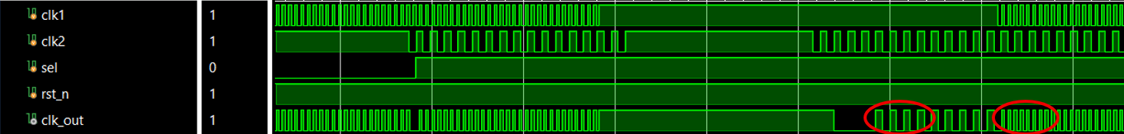
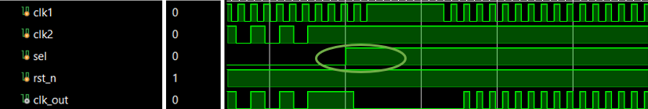
Proven:

Slide 21
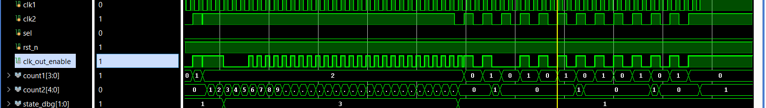
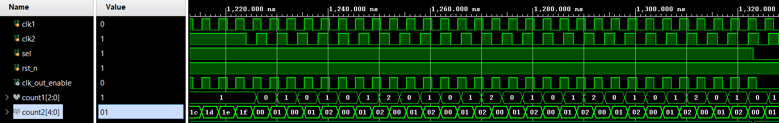

Slide 22
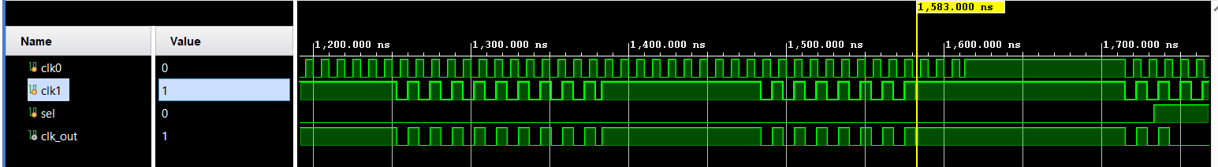
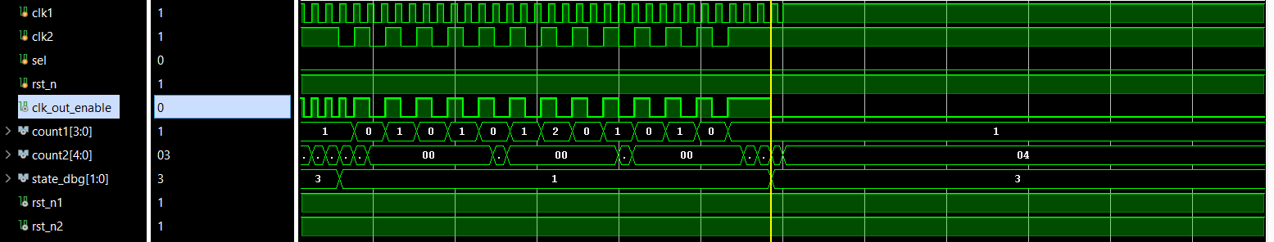
Solved problems:
Old version: cannot solve
New version: can solve

Slide 23
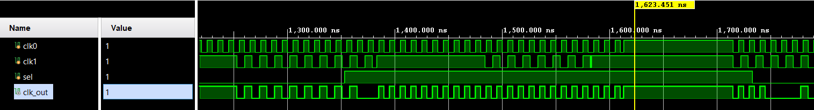
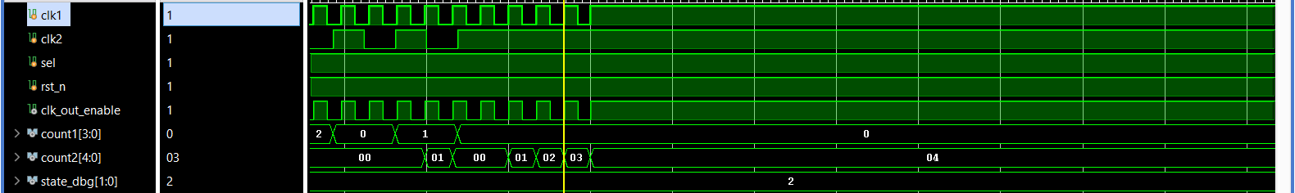
Still can’t solve
Old
New

Slide 24
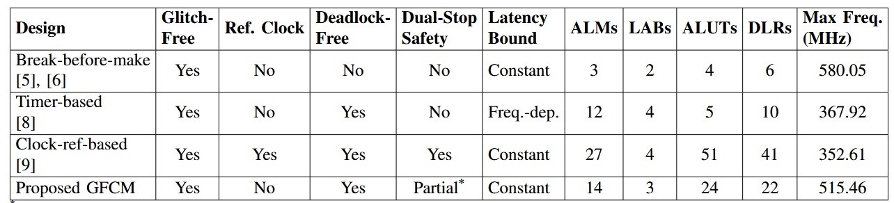
Table: Feature and Implementation Comparison for Various Clock Multiplexer Designs

Slide 25
Conclusion
Proposed a fully autonomous, robust GFCM for high-reliability systems
Ensures:
Glitch-free switching
Deadlock-free operation
Automatic recovery
Safe handling of clock failures (including simultaneous loss)
No external reference clock required

Slide 26
Future Work
Extend the architecture to support multiplexing of more than two clock domains for complex SoC systems
Explore ultra-low-power optimizations via adaptive failure detection and resource-efficient monitoring logic

Slide 27
Thank you for your attention!

